Slide 1
Digital Portfolio
STUDENT NAME: Mageswar R
REGISTER NO AND NMID: 0F488840727CEDFA1E44013067AC6090/212402379
DEPARTMENT: BCA
COLLEGE: AGURCHAND MANMULL JAIN COLLEGE
UNIVERSITY: Madaras university

Slide 2
PROJECT TITLE
Digital Portfolio

Slide 3


AGENDA
Problem Statement
Project Overview
End Users
Tools and Technologies
Portfolio design and Layout
Features and Functionality
Results and Screenshots
Conclusion
Github Link
3/21/2024 Annual Review

Slide 4

PROBLEM STATEMENT
In today’s competitive environment, having a professional digital presence is essential. Traditional resumes and paper portfolios lack interactivity and accessibility. A digital portfolio allows potential employers and collaborators to explore skills, projects, and achievements in a visually appealing and interactive way.

Slide 5

PROJECT OVERVIEW
The project focuses on creating a modern, responsive, and user-friendly portfolio website. The portfolio showcases academic background, skills, certifications, services, and projects. It highlights capabilities in data analysis, UI/UX, and frontend development.

Slide 6

WHO ARE THE END USERS?
1. Recruiters and Hiring Managers looking for potential candidates.
2. Academic institutions evaluating student projects.
3. Fellow students and collaborators for project contributions.
4. General audience interested in learning about skills and achievements.

Slide 7

TOOLS AND TECHNIQUES
Tools and Technologies
Tools: Html ,CSS, Java script
Icons & Fonts: Google Fonts, Font Awesome
Version Control: Vscode & GitHub

Slide 8
POTFOLIO DESIGN AND LAYOUT
The design follows a modern dark theme with clean typography and visual hierarchy. Sections include About, Skills, Portfolio, Services, Experience, and Certifications. Navigation is simple, and the layout is responsive for all screen sizes.
8

Slide 9
FEATURES AND FUNCTIONALITY
• Responsive web design for mobile and desktop.
• Interactive navigation menu.
• Separate sections for About, Skills, Portfolio, Services, Experience, and Certifications.
• Links to resume download and GitHub repository.
• Visual display of certifications and portfolio projects.

Slide 10
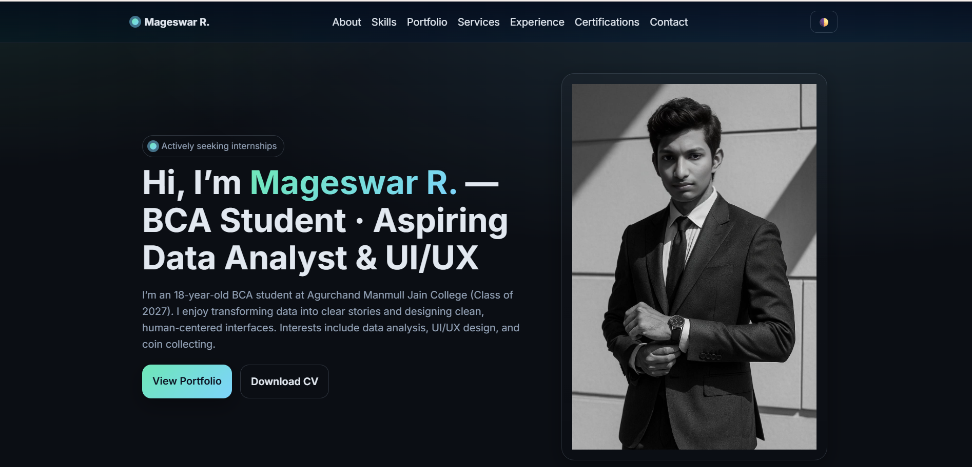

RESULTS AND SCREENSHOTS
• Responsive web design for mobile and desktop.
• Interactive navigation menu.
• Separate sections for About, Skills, Portfolio, Services, Experience, and Certifications.
• Links to resume download and GitHub repository.
• Visual display of certifications and portfolio projects.
3/21/2024 Annual Review
10

Slide 11
CONCLUSION
The portfolio serves as a comprehensive digital identity. It demonstrates academic progress, technical skills, and professional aspirations. It is a valuable tool for applying to internships, entry-level roles, and collaborations.
11

Slide 12
GITHUB repositories:
https://github.com/Mageswar13/portfolio1.git
GITHUB portfolio link:
https://mageswar13.github.io/portfolio1/

